Slide 1

AIR TRAVEL ANALYSIS IN AUSTRALIA

Slide 2
International Travel Trends to and from Australia (2000-2022)
Presenter: Asha Kozak

Slide 3
International Travel Trends to and from Australia
(2000-2022)
The dataset includes information on passenger movement between Australian and foreign ports in years 2000-2022.
The analysis focuses on understanding top destinations, seasonal patterns, and identifying popular Australian ports.

Slide 4
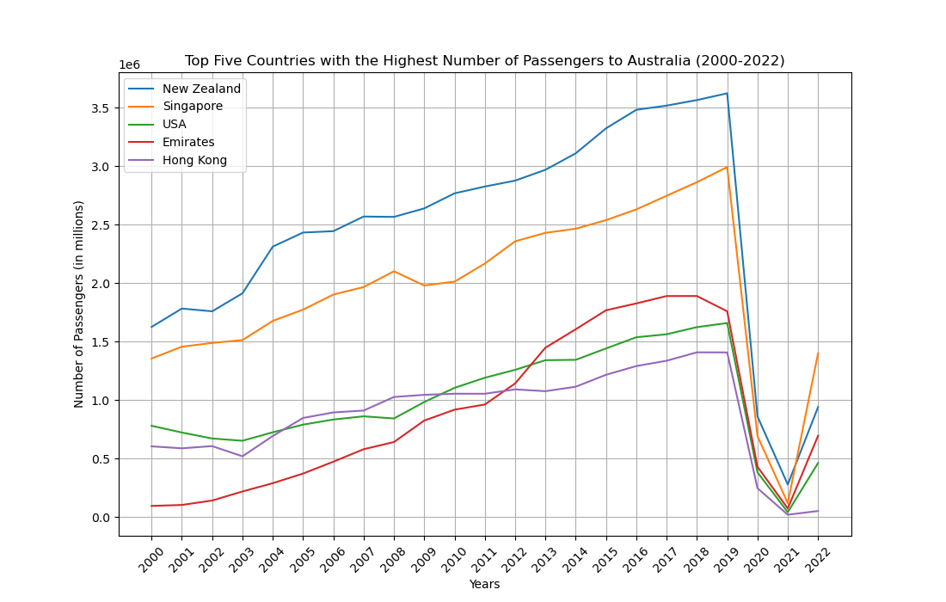
Top Five Countries In

Slide 5
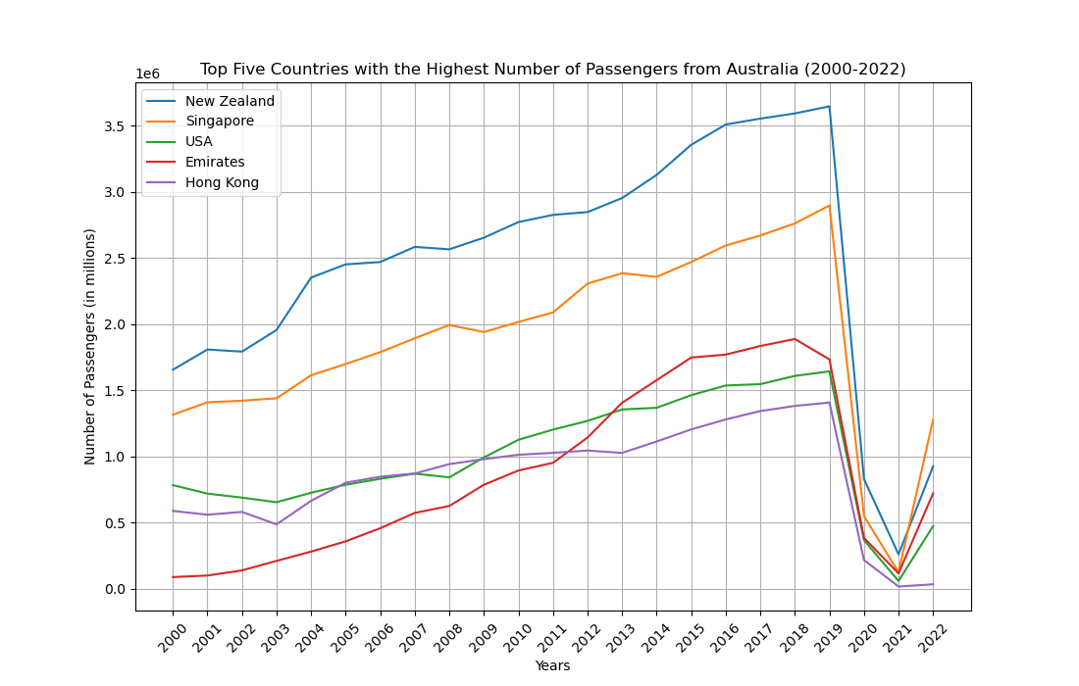
Top Five Countries Out

Slide 6
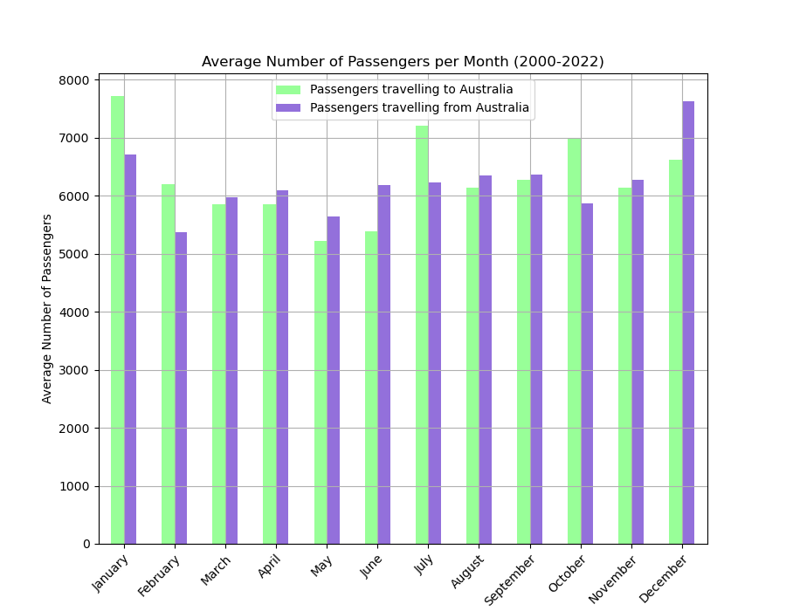
Seasonal Patterns

Slide 7
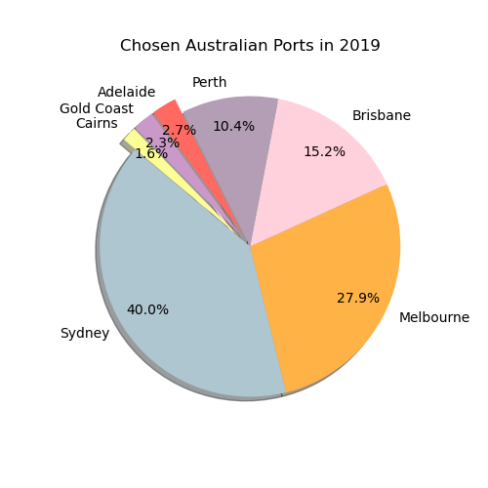
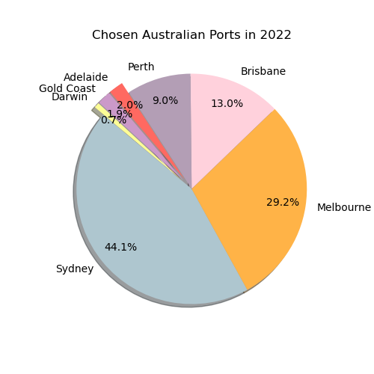
Most Popular Australian Ports in 2019 and 2022

Slide 8
Seasonal Trends in International Travel to Australia
(2000 – 2022)
Presenter: Jancel Adiong

Slide 9
Seasonal Trends in International Travel to Australia
(2000 – 2022)
The dataset includes information on monthly international movement of travellers to Australia from 2000 - 2022
The analysis focuses on determining the busiest season on international travellers to Australia, most visited local cities, and busiest season of top local cities.

Slide 10
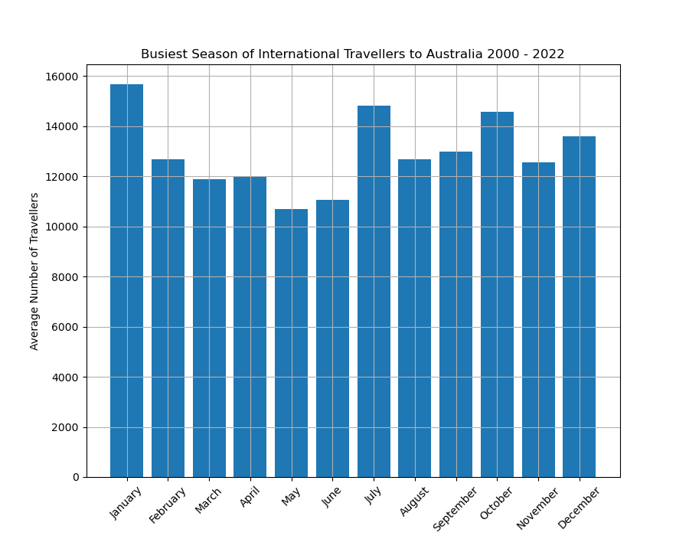
Busiest Season of International Travellers

Slide 11
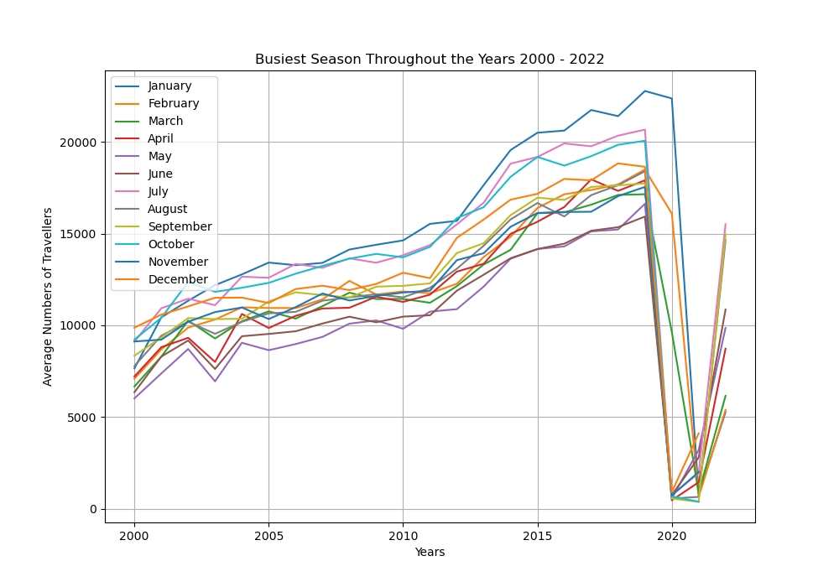
Busiest Season Throughout the Years

Slide 12
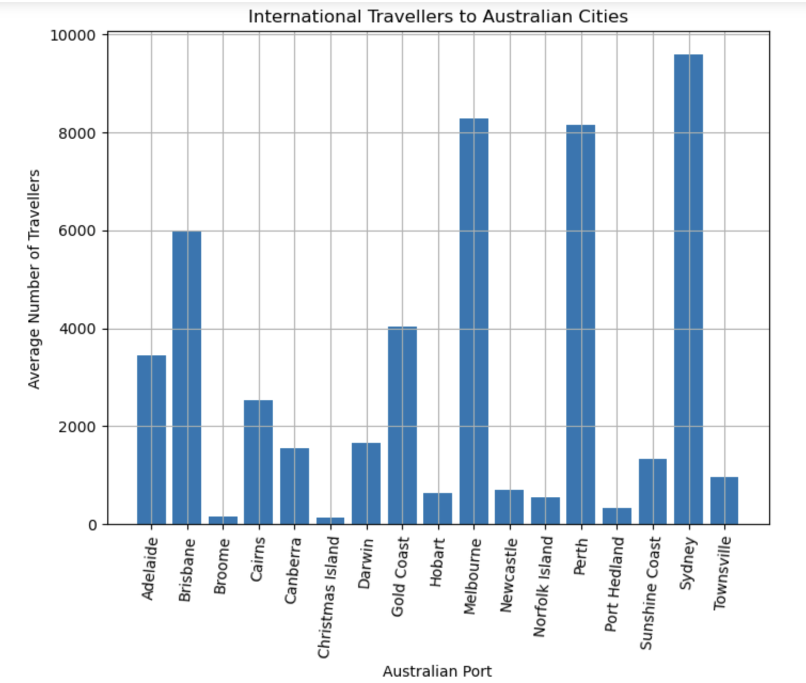
Top Australian Cities

Slide 13
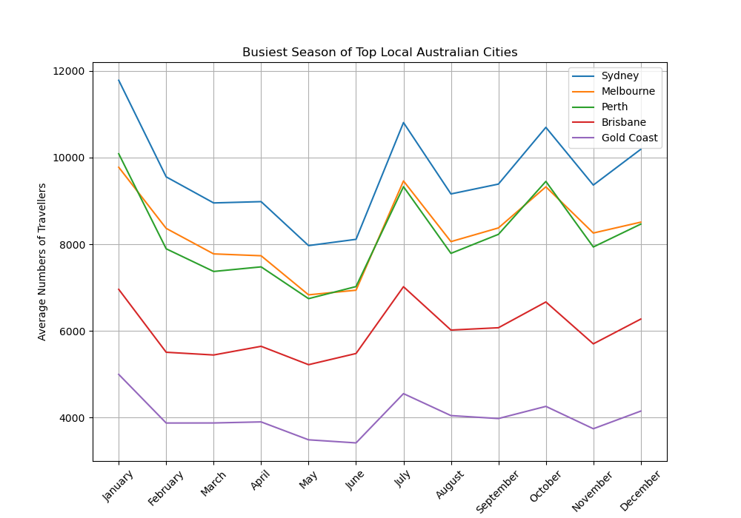
Busiest Season of Top Australian Cities

Slide 14
Comparison between Domestic and International passengers travelling within Australian Airports (2000-2022)
Presenter: Jorge Chicas

Slide 15
Comparison between Domestic and International passengers travelling within Australian Airports (2000-2022)
The dataset includes information on domestic and international passenger movement between 8 Australian Airports from 2000-2022.
The analysis focuses on comparing the most frequented airport, the total number of passengers, and the monthly peaks per airport between Domestic and International passengers.

Slide 16
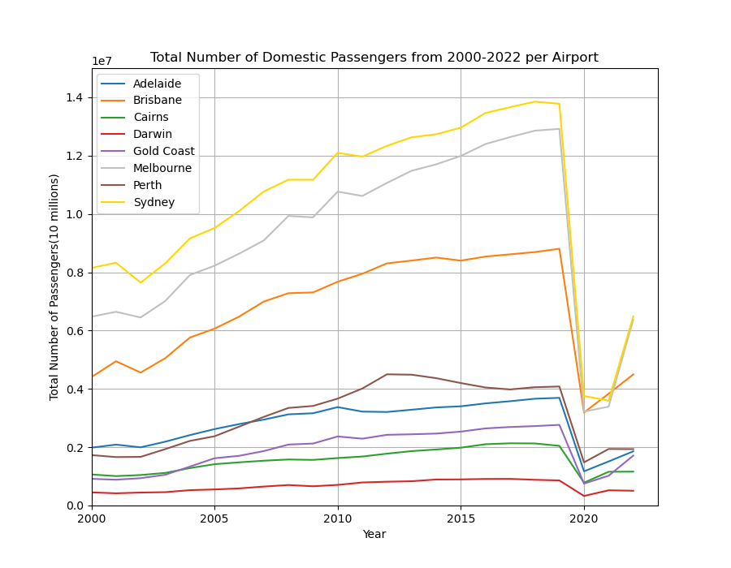
Domestic Passenger Visits per Airport

Slide 17
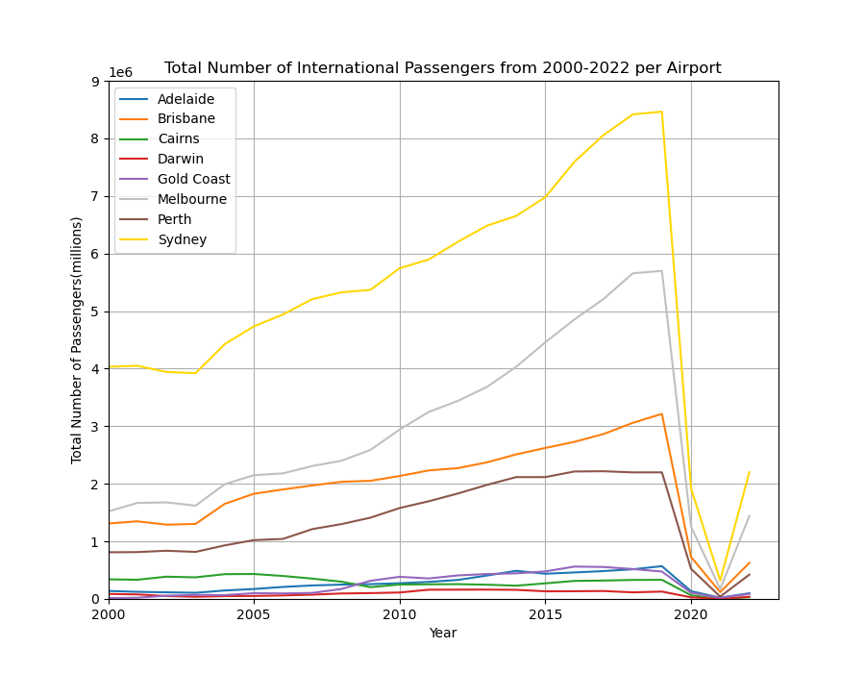
International Passenger Visits per Airport

Slide 18
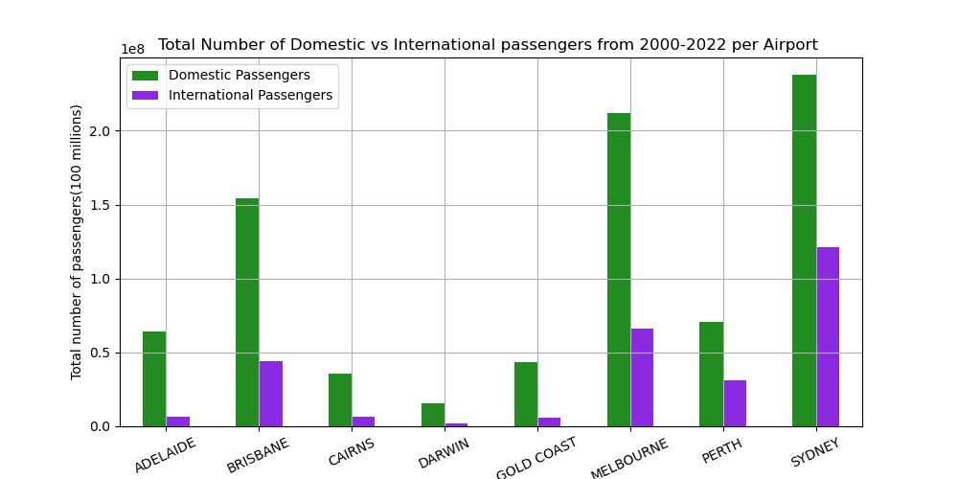
Total Number of Domestic and International Visits per Airport

Slide 19
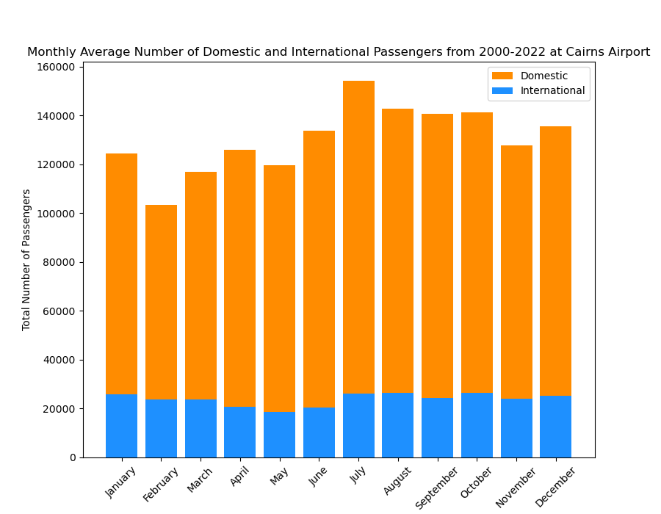
Monthly Average Number of Domestic and International Passengers Visiting Cairns Airport

Slide 20
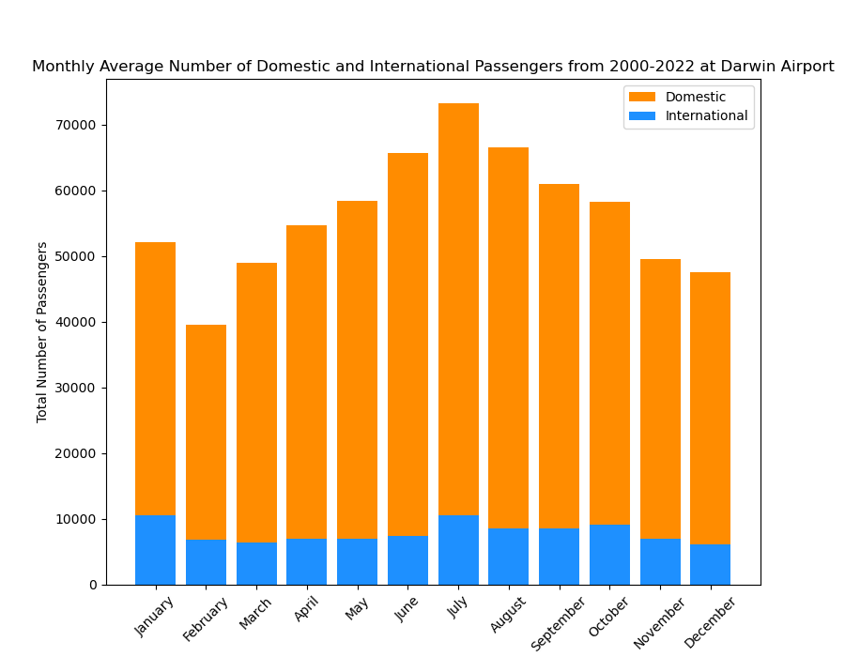
Monthly Average Number of Domestic and International Passengers Visiting Darwin Airport

Slide 21
International Passenger Airline Analysis: Australia
(2003 - September 2022)
Presenter: Jyotsna Jayaraman

Slide 22
International Passenger Airline Analysis: Australia
(2003 - September 2022)
Identifying top inbound and outbound passenger airlines of Australia
Calculating seat utilization % on flights to various country ports and their correlation with port popularity by number of passengers if any
Popular international port cities by total number of flights
Analysing some country ports to identify consistent high seat utilization

Slide 23
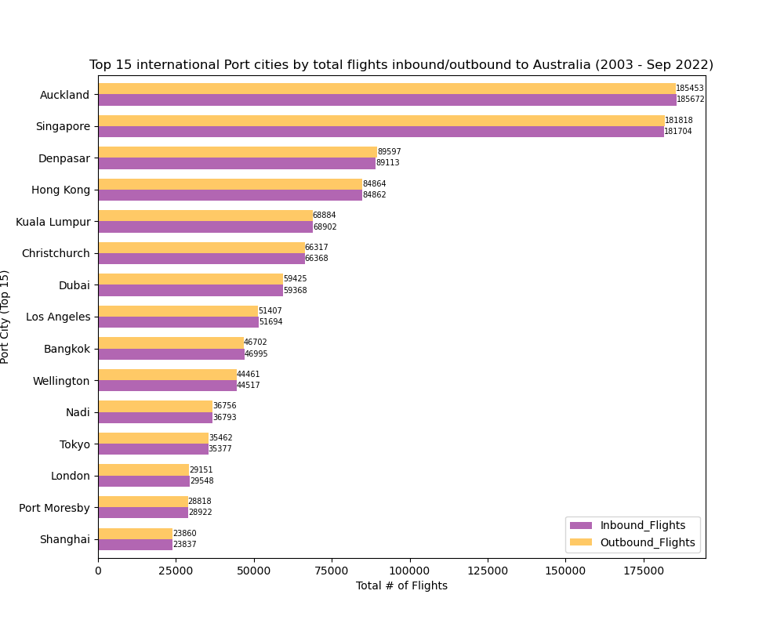
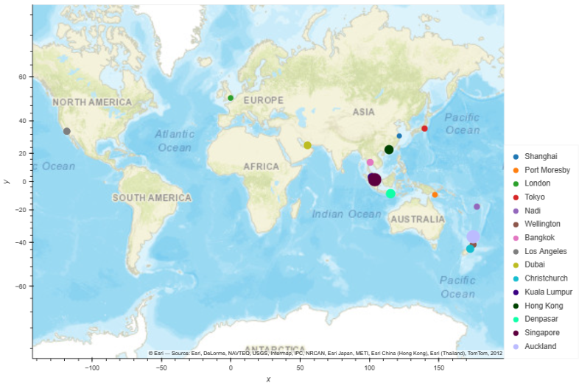
Top 15 international Port Cities by Total Inbound/Outbound Flights Australia (2003 – September 2022)
INSERT GRAPH

Slide 24
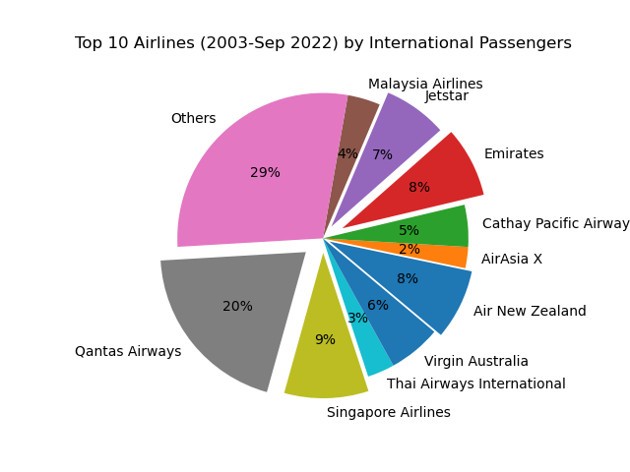
Top Airlines by Number of International Passengers
(2003 - September 2022)
INSERT GRAPH

Slide 25
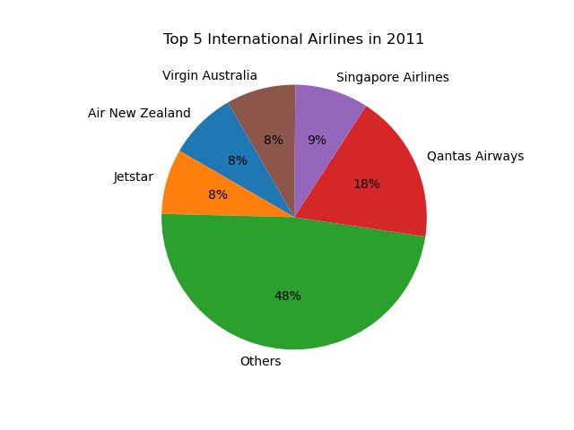
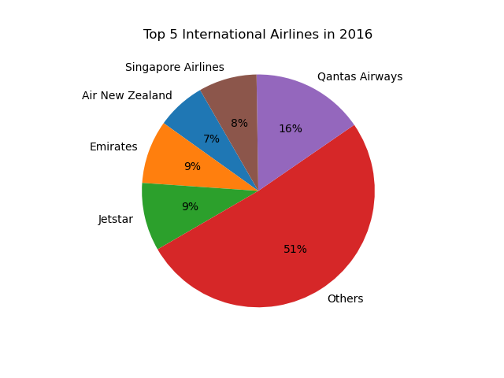
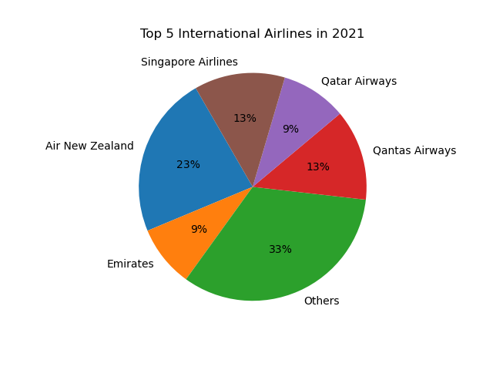
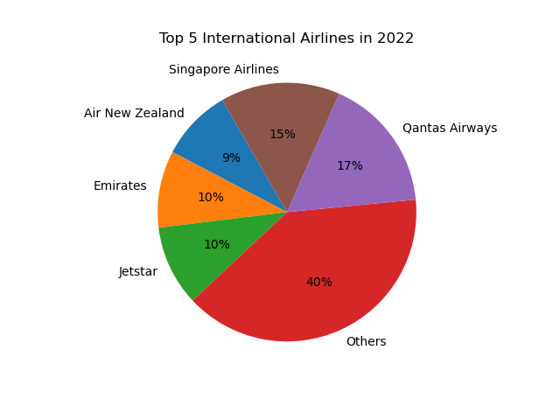
Top 5 Airlines in 2011, 2016, 2021 and 2022
INSERT GRAPH

Slide 26
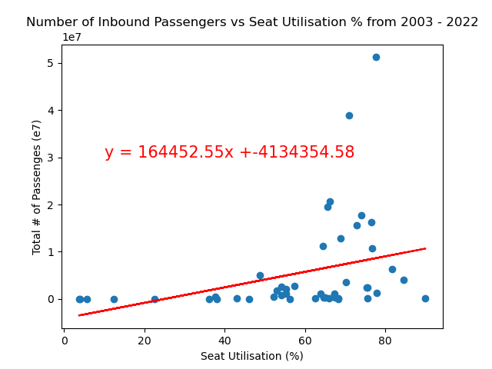

Seat Utilization % vs Number of Passengers
per Country Port
INSERT GRAPH

Slide 27
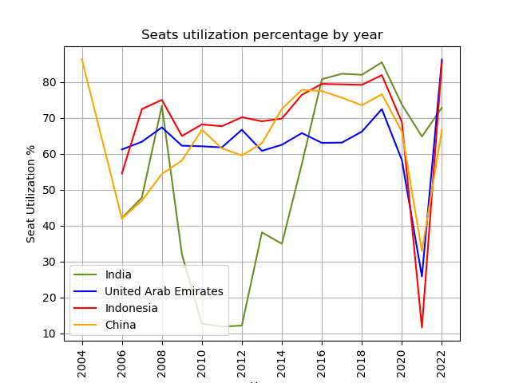
Seat Utilization Trends for Four Selected Countries
INSERT GRAPH

Slide 28
Bon voyage!

